Slide 1
PHASE ARRAY SPEAKER SYSTEM
By,
MohammedArsath(120051601063)
RajaRaman.G(120051601094)
Rohit Kumar.S(120051601101)
Final Year, ECE - B

Slide 2
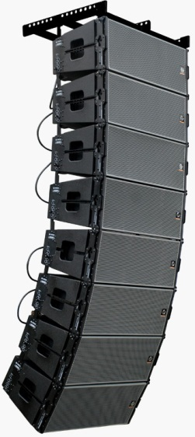
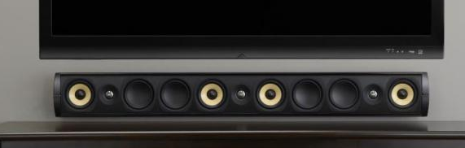
PHASE ARRAY SPEAKERS
Over the past few decades, digital signal processors (DSPs) have become available at a reasonable cost. This forces the question Now that it is possible to individually control the magnitude and phase of every loudspeaker in an array called phase array speaker system.
Manipulating the magnitude and phase of every loudspeaker in an array of loudspeakers is commonly referred to as “beam steering.”
Line Array systems
Phase Array systems

Slide 3
OBJECTIVE
The aim of the phased array speakers is to provide the maximum sound coverage over an entire area along with best sound clarity. The voices and the sound effects could be more easily differentiated. This system is comparatively cheaper when compared with its counterparts.

Slide 4
INTRODUCTION
A phased array speaker system to generate flexible, directional sound.
The system samples a standard audio input signal at approximately 44.1 kHz, and then outputs this signal to each of 6-12 speakers, each with a variable delay.
This simple technique allows audio frequency sound to be heard in only selected regions within the room or other auditory space.
Multiple regions with multiple soundtracks can be created by simultaneously playing variously delayed soundtracks over each of the speakers in the array.
Sound waves from different loudspeakers can both combine or cancel depending on the relative phase relationships between the sound waves, it is possible to manipulate the phase (and magnitude) of the sound from two or more loudspeakers to control where the sound cancels and where the sound sums.

Slide 5
HARDWARE DESIGN
X12
STANDARD AUDIO INPUT
INPUT BUFFER/LEVEL SHIFTER
AADC
ATMEGA 644 MICROCONTROLLER
DAC
SPEAKER AMPLIFIER

Slide 6
SOFTWARE USED
WinAVR used for programming the microcontroller.

Slide 7
APPLICATIONS
Quadraphonic
Sonar testing apparatus
Enhancing bass

Slide 8
WORK FLOW
PHASE | WORKS TO BE DONE | DURATION
1 | PROGRAMMING AND TESTING | 1 WEEK
2 | HARDWARE COMPONENTS FABRICATION AND INSTALLATION | 2 WEEKS
3 | CONSTRUCTION OF THE STRUCTURE | 1.5 WEEKS
4 | PREPARATION OF THE FINAL REPORT | 1 WEEK

Slide 9
REFERENCES
Paul Crilly, Richard Hartnett, Rosie Santrach, Carlos Palenzuela Department of Engineering, Electrical Engineering, U.S. Coast Guard Academy, New London “A Novel Approach to Teaching Phased Array Antenna Systems ”

Slide 10
THANK YOU

